Slide 1


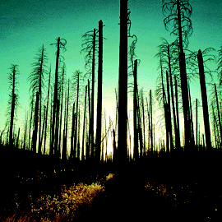





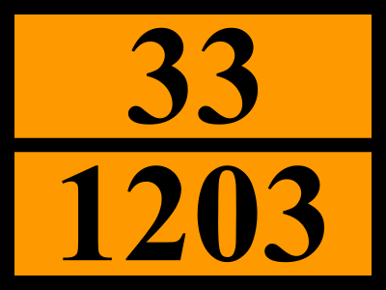
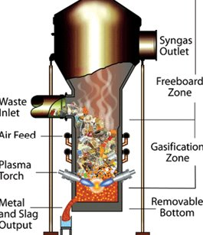


three years after their participation in the first international symposium
‘Locals’ torn between concerns and positivism
growing confidence between the actors, yet lots of questions still to be answered
Contributors: the locals - Poster for locals’ symposium 2013, translated from Dutch
Abstract
ABSTRACT
‘Locals’ represent concerned population around Remo Landfill where ELFM-project is to be started.
  So far, population of Houthalen-Helchteren and surroundings have only seen negative impact of waste treatment:
    Waste incinerator at Houthalen (approx. 80.000 Tonnes/Yr since 1984), often subject of negative newsreports
    Landfill Remo Helchteren (since early 70’s): 18 Mio. Tonnes of filth burried in our back-yard?
  And now, another unhealthy (or shall we call it insane?) waste project in our community?
Worries and anger concern odour/stench, declining mobility, unsafe roads, threats to public health (fine dust, soot particles,… )
…
…
…
…
…
Impact on Environment
Social Impact
Air, CO₂ processing
Water and soil
Wildlife, biodiversity
How do you ‘restore’ nature?
By cutting down woods?
Risk for stench
Local Community torn and divided – fierce emotions for and against
What’s in it for the local community? And how?
-nature? When - if at all realistic?
-energy/power/heat? For whom?
-jobs? How many FTE’s? what kind of jobs?
-financially? (Town, population?)
Or is Machiels (once again) the only winner and the locals get the burden (again)?
-green energy? The tax-payer will ‘gladly’ invest, but others will happily harvest the return?
Technology & Approach
Digging it up in open air without protective measures?
They are not going to transport everything elsewhere for processing, are they?
(= mobility infarct + risks for humans & environment)
Plasmatechnology: fairy tale, nightmare?
Remo is a test case: so what if it goes wrong?
When is it all going to end? And how can we be sure of that? (or will ‘someone’ just adapt the permit according to the industrial need?)
Any guarantee that site really will be left to nature after 20 yrs?
Energy balance: worthwhile or sheer scientist’s theoretical arrogance?
Hydrogen? Natural gas? Plasma? a BOMB?
What will they do with the final fraction? (plasmarock, fly-ash, unprocessables, hazardous cocktails?
Independent judging of health and safety? A SEVESO-site by regulations?
Traffic Impact
  During construction?
  During operation: 50-100 trucks per day extra on the nearby roads for semi-finished or w-t-m-product?
  + yet again incoming freight (high caloric waste, needed for constant plasma-feed?
  Critized new-to-build highway (through natural reserve) absolutely necessary
Communication & Follow-up
Will all questions that were raised during locals meetings also be examined and answered?
Will they also been taken into account and how?
What is our continued involvement in this project after the Conference?
How will the population get informed and when?
Health Impact
500 Ktonnes/Yr Waste-to-Energy = another form of incineration? Exhaust Limits absolute? Detection limits accounted for? Low enough? Pass = healthy???
Any studies known about ultra-fine dust? And its consequences?
Baseline Measurement of current level of pollution in the bodies of local population?
What is the EWS Early Warning System?
Which part of population will be monitored c.q. safeguarded? And thus: who will NOT be…

